Slide 1
CLASS 2

Slide 2
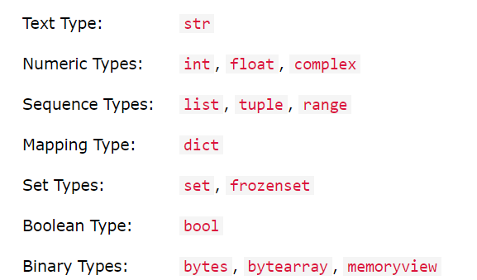
Python Data Types
Built-in Data Types
In programming, data type is an important concept.
Variables can store data of different types, and different types can do different things.
Python has the following data types built-in by default, in these categories:

Slide 3
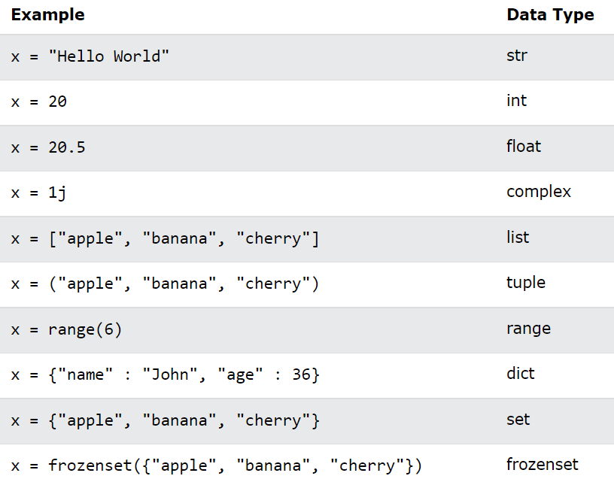
Setting the Data Type
In Python, the data type is set when you assign a value to a variable:

Slide 4
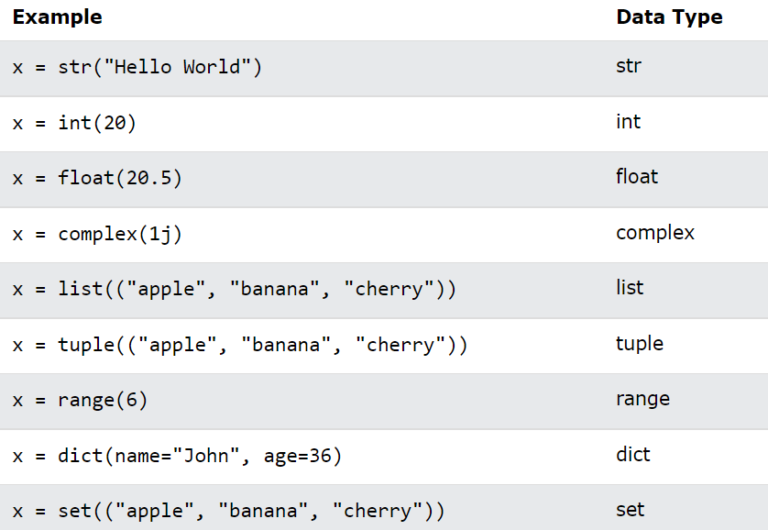
Setting the Specific Data Type
If you want to specify the data type, you can use the following constructor functions:

Slide 5
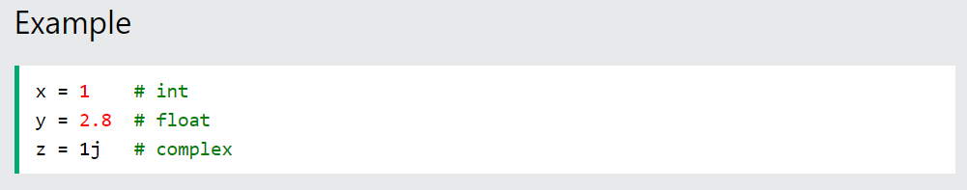
Python Numbers
There are three numeric types in Python:
int
float
complex
Variables of numeric types are created when you assign a value to them:

Slide 6
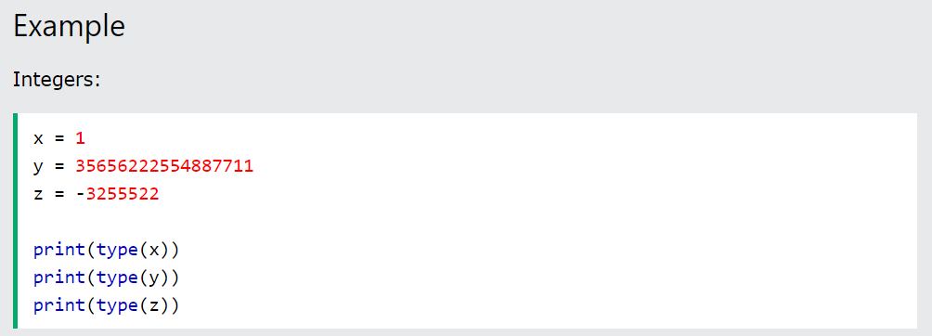
Int
Int, or integer, is a whole number, positive or negative, without decimals, of unlimited length.

Slide 7
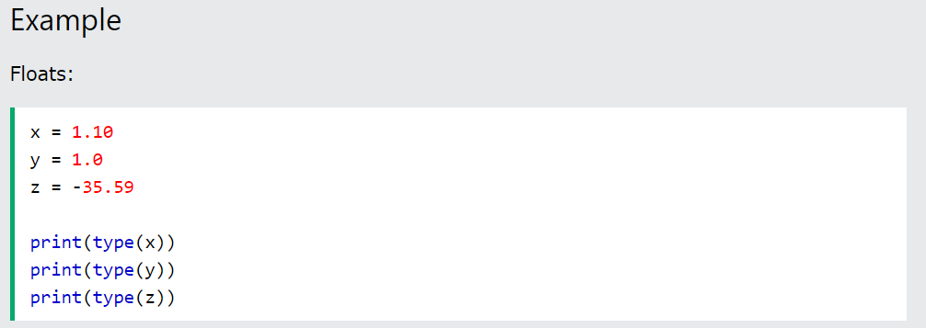

Float
Float, or "floating point number" is a number, positive or negative, containing one or more decimals.
Float can also be scientific numbers with an "e" to indicate the power of 10.
Example :

Slide 8
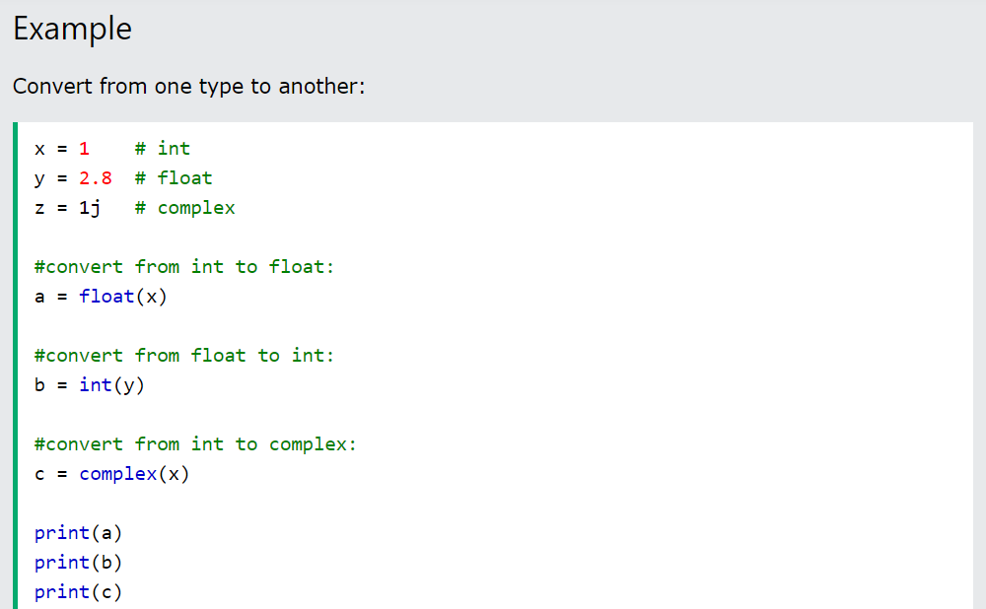
Type Conversion
You can convert from one type to another with the int(), float(), and complex() methods:

Slide 9
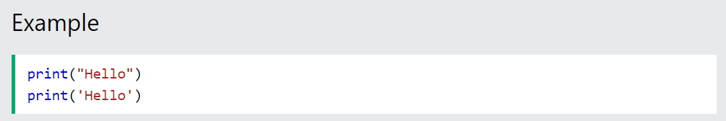
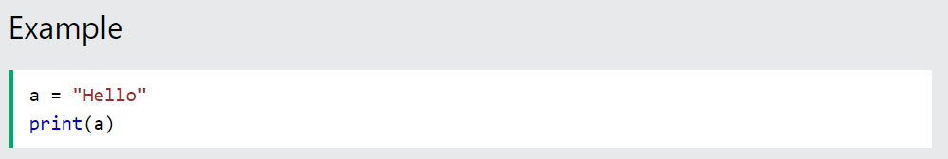
Strings in Python
A string is a sequence of characters. It can be declared in python by using double-quotes. Strings are immutable, i.e., they cannot be changed
Assign String to a Variable
Assigning a string to a variable is done with the variable name followed by an equal sign and the string:

Slide 10
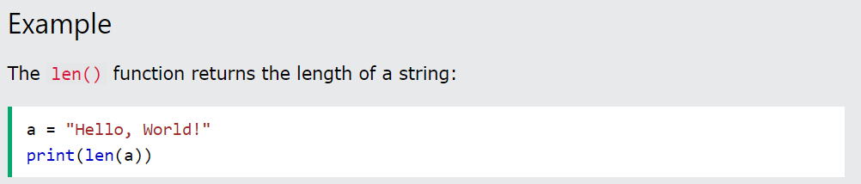
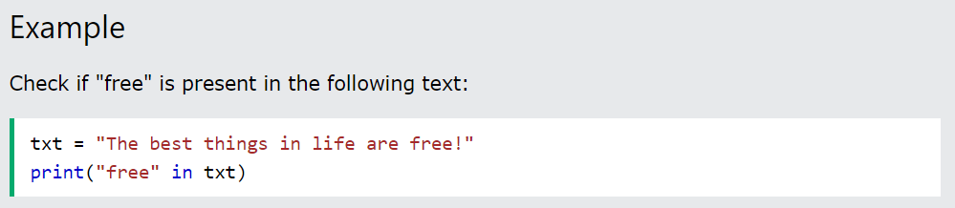
String Length
To get the length of a string, use the len() function.
Check String
To check if a certain phrase or character is present in a string, we can use the keyword in.

Slide 11
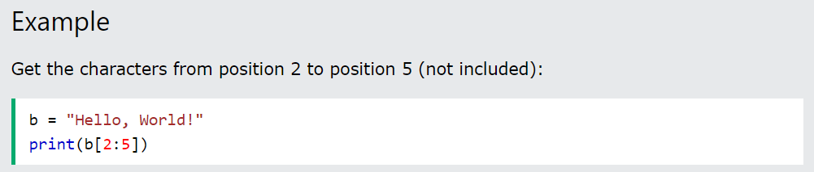
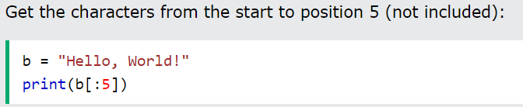
Slicing in strings
You can return a range of characters by using the slice syntax.
Specify the start index and the end index, separated by a colon, to return a part of the string.
Note: The first character has index 0
Slice From the Start
By leaving out the start index, the range will start at the first character:

Slide 12
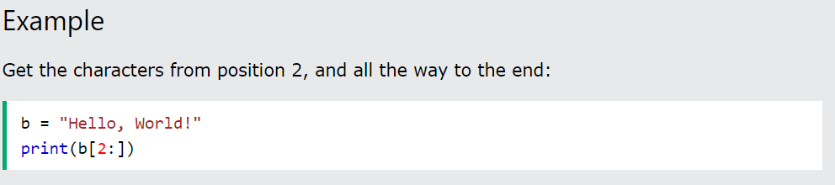
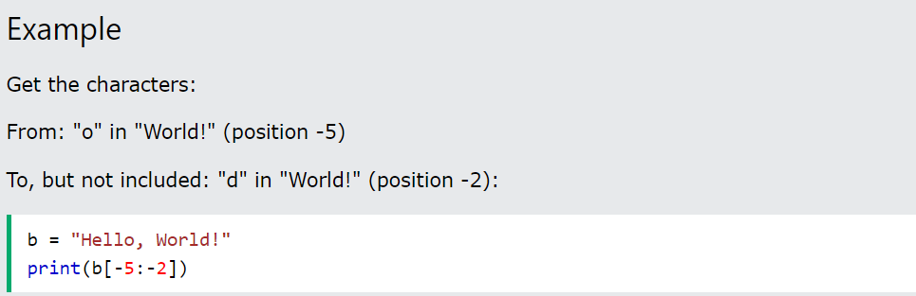
Slice To the End
By leaving out the end index, the range will go to the end:
Negative Indexing
Use negative indexes to start the slice from the end of the string:

Slide 13
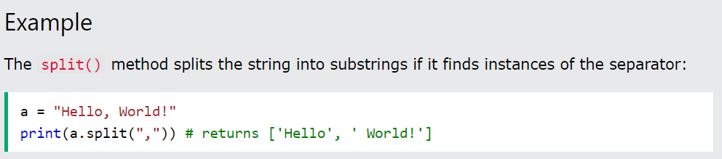
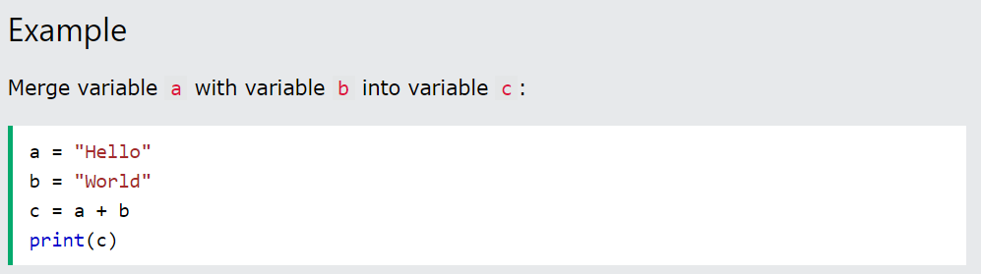
Split String
The split() method returns a list where the text between the specified separator becomes the list items.
String Concatenation
To concatenate, or combine, two strings you can use the + operator.

Slide 14
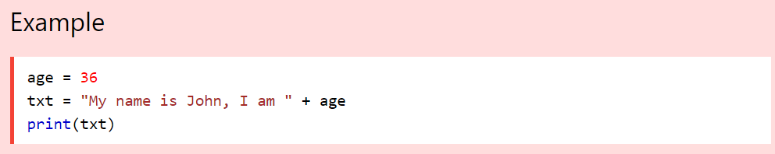
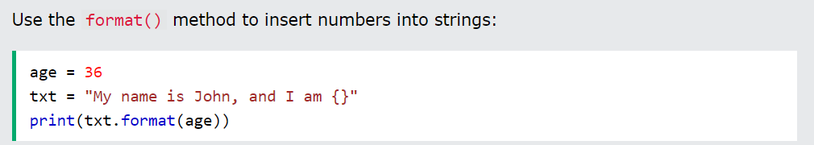
String Format
As we learned in the Python Variables chapter, we cannot combine strings and numbers like this:
But we can combine strings and numbers by using the format() method!
The format() method takes the passed arguments, formats them, and places them in the string where the placeholders {} are:
The format() method takes unlimited number of arguments, and are placed into the respective placeholders

Slide 15
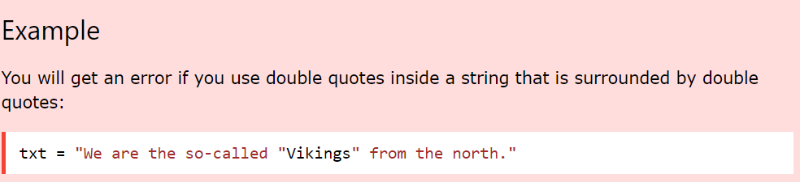
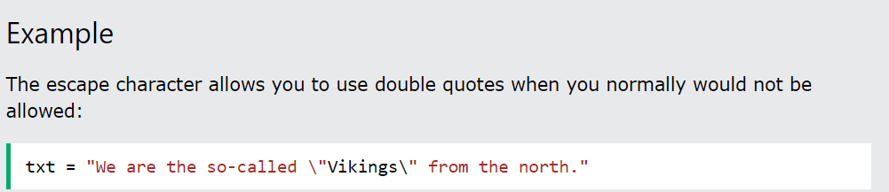
Escape Character
To insert characters that are illegal in a string, use an escape character.
An escape character is a backslash \ followed by the character you want to insert.
An example of an illegal character is a double quote inside a string that is surrounded by double quotes:
To fix this problem, use the escape character \":

Slide 16
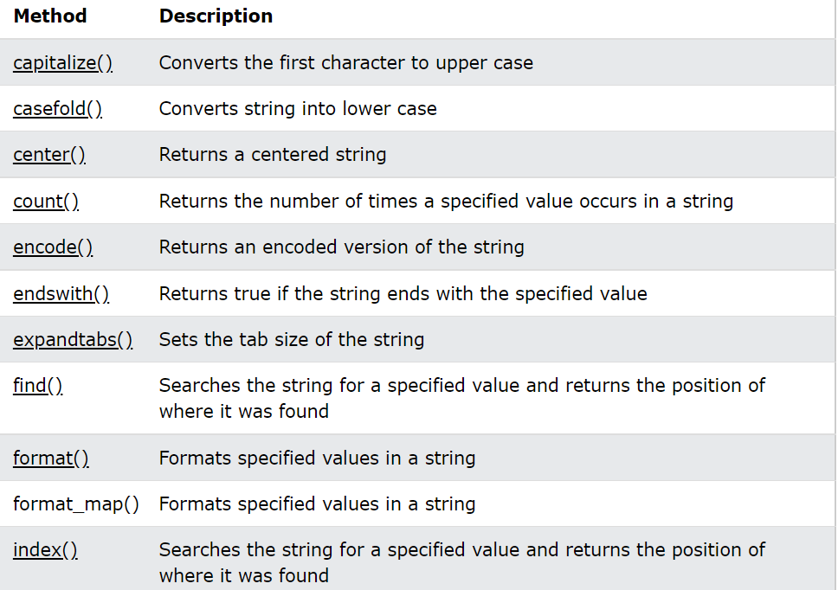
String Methods
Python has a set of built-in methods that you can use on strings.
Note: All string methods returns new values. They do not change the original string.

Slide 17
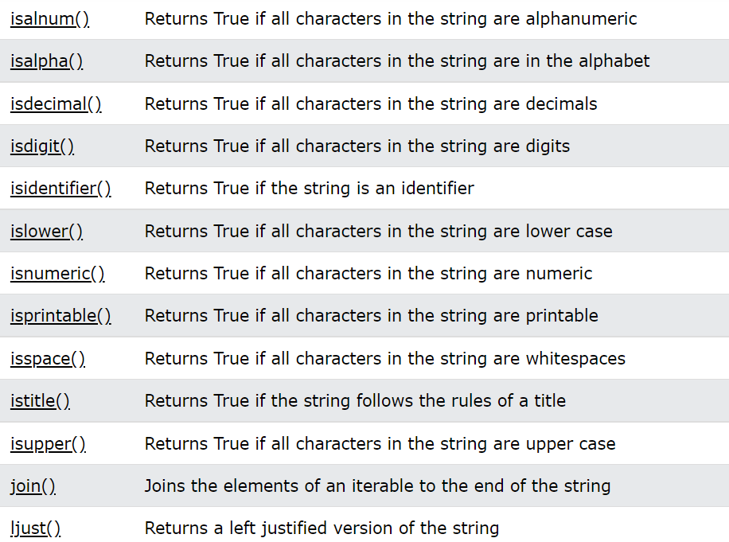

Slide 18
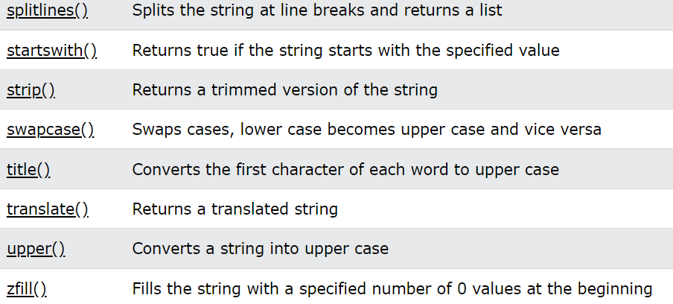

Slide 19
Escape Sequencing in Python
While printing Strings with single and double quotes in it causes Syntax Error because String already contains Single and Double Quotes and hence cannot be printed with the use of either of these. Hence, to print such a String either Triple Quotes are used or Escape sequences are used to print such Strings.
Escape sequences start with a backslash and can be interpreted differently. If single quotes are used to represent a string, then all the single quotes present in the string must be escaped and same is done for Double Quotes.

Slide 20
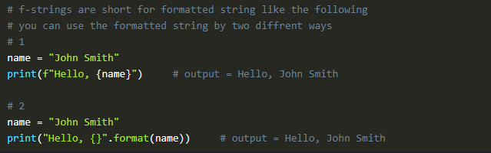
F Strings In Python
Python offers a powerful feature called f-strings (formatted string literals) to simplify string formatting and interpolation. f-strings is introduced in Python 3.6 it provides a concise and intuitive way to embed expressions and variables directly into strings. The idea behind f-strings is to make string interpolation simpler.

Slide 21
Thanks

